Slide 1
Internet Protocol Version 6
Course Code: CSC 3116
Course Title: Computer Networks
Dept. of Computer Science
Faculty of Science and Technology
Lecturer No: | 10 | Week No: | 10 | Semester: | Summer 19_20
Lecturer: | Shahrin Chowdhury, shahrin@aiub.edu

Slide 2
Lecture Outline
To introduce the IPv6 addressing scheme and different notations used to represent an address in this version.
To explain the three types of addressing used in IPv6: unicast, anycast, and multicast.
To show the address space in this version and how it is divided into several blocks.
To discuss some reserved blocks in the address space and their applications.
To define the global unicast address block and how it is used for unicast communication.
To discuss how three levels of hierarchy in addressing are used in IPv6 deploying the global unicast block.
To discuss auto configuration and renumbering of IPv6 addresses.

Slide 3
Measurement of 128 bit
Lets go to the previous Examples. . .
2001:0211:00AB:0000:0000:0000:0000:0001
Working in the 1st Hexted we can see
2 = 0010 (4-bit)
0 = 0000 (4-bit)
0 = 0000 (4-bit)
1 = 0001 (4-bit)
----------------------------------------
= Total 16 bit in One Hexted.
In total :- 16 bit * 8 Hexted = 128 bit.

Slide 4
How to Shorten IPv6 Address
Leading Zero Can be Omitted.
Consecutive Hexted of Zeros can be represented/replaced by double colon (::).
Double colon can only be used once in an IPv6 Address.
2001:0211:00AB:0000:0000:0000:0000:0001
=According to the rules, we can write
2001:211:AB:0:0:0:0:1 -Leading 0’s are omitted
2001:211:AB::1 - Consecutive 0 means (::)
Already Used one double colon.
Final Shorten IP address:-
2001:211:AB::1

Slide 5
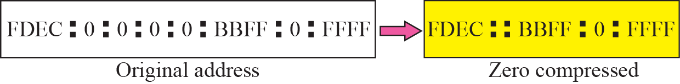
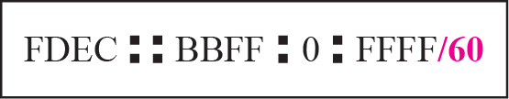
More Examples
Examples without CIDR:-
Examples with CIDR:-

Slide 6
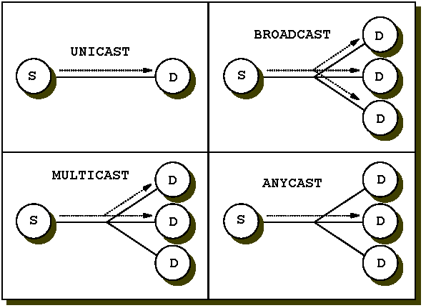
Types of ipv6 Address

Slide 7
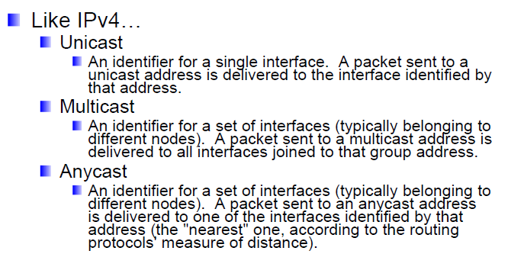
Types of ipv6 Address (cont…)

Slide 8
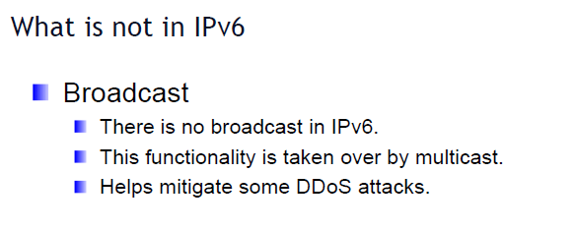
What is removed in ipv6

Slide 9
CIDR Notation in ipv6
2001:0211:00AB:0000:0000:0000:0000:0001
1-16 17-32 33-48 49-64 65-80 81-96 97-112 113-128 bits
Here , first 2001 = 0010 0000 0000 0001
/3 is called IANA Prefix. (001 is the 1st 3-bits.)
/23 is called RIR Prefix.
/32 is called IPS Prefix. (Example:-BTCL)
/48 is called Site Prefix. (Example:-AIUB)
/64 is called Subnet bit.
From 64 to 128 is called as Host ID.

Slide 10
Problem set
Show the unabbreviated colon hex notation for the following IPv6 addresses:
a. An address with 64 0s followed by 64 1s.
b. An address with 128 0s.
c. An address with 128 1s.
d. An address with 128 alternative 1s and 0s.
Solution:-
a. 0000:0000:0000:0000:FFFF:FFFF:FFFF:FFFF
b. 0000:0000:0000:0000:0000:0000:0000:0000
c. FFFF:FFFF:FFFF:FFFF:FFFF:FFFF:FFFF:FFFF
d. AAAA:AAAA:AAAA:AAAA:AAAA:AAAA:AAAA:AAAA

Slide 11
Problem set (cont…)
Show abbreviations for the following addresses:
a. 0000:0000:FFFF:0000:0000:0000:0000:0000
b. 1234:2346:0000:0000:0000:0000:0000:1111
c. 0000:0001:0000:0000:0000:0000:1200:1000
d. 0000:0000:0000:0000:0000:FFFF:24.123.12.6
Solution
a. 0:0:FFFF::
b. 1234:2346::1111
c. 0:1::1200:1000
d. ::FFFF:24.123.12.6

Slide 12
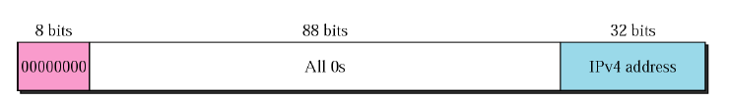
Convert IPv4 to IPv6
First 8 bits 0, following 88 bits will also be zero, last 32 bits will be the IPv4 address.
IPv4 address: 192.168.10.62
Convert it into IPv6
Representing each octet with 8 bits binary:
192 = 1100 0000 = C0
168 = 1010 1000 = A8
10 = 0000 1010 = 0A
62 = 0011 1110 = 3E
IPv6 address will be: 0::C0A8:0A3E

Slide 13
Link Local Address
All the link local address starts with FE80
It is used for retrieving MAC address
FE80::5D39:84FF:FE29:3064
Rules to convert link local into MAC Address:
i) Drop the First four Hextets
ii) Flip the 7th bit of 5th Hextet
iii) Drop the 2nd Octet of 6th Hextet
iv) Drop the 1st Octet of 7th Hextet
FE80::5D39:84FF:FE29:3064
drop flip drop
5D39=0101110100111001 0101111100111001
7th bit flip 5F39
MAC address: 5F39:8429:3064

Slide 14
IPv6 prefixes
The prefix 2001:db8::/32 is a special IPv6 prefix that is used specifically for documentation examples
2001:db8:3c4d:15::/64 The subnet prefix always contains 64 bits. These bits include 48 bits for the site prefix, in addition to 16 bits for the subnet ID.
fe80::/10 Indicates that a link-local address follows.
ff00::/8 Indicates that a multicast address follows.
AFE0:1111:0001:0000:0000:0000:0000:0001
AFE0:1111:1::1

Slide 15
References
Data Communications and Networking, B. A. Forouzan, McGraw-Hill, Inc., Fourth Edition, 2007, USA.
https://www.geeksforgeeks.org/basics-computer-networking/
https://www.tutorialspoint.com/computer_fundamentals/computer_networking.htm

Slide 16
Books
Data Communications and Networking, B. A. Forouzan, McGraw-Hill, Inc., Fourth Edition, 2007, USA.
Computer Networking: A Top-Down Approach, J. F., Kurose, K. W. Ross, Pearson Education, Inc., Sixth Edition, USA.
Official Cert Guide CCNA 200-301 , vol. 1, W. Odom, Cisco Press, First Edition, 2019, USA.
CCNA Routing and Switching, T. Lammle, John Wily & Sons, Second Edition, 2016, USA.
TCP/IP Protocol Suite, B. A. Forouzan, McGraw-Hill, Inc., Fourth Edition, 2009, USA.
Data and Computer Communication, W. Stallings, Pearson Education, Inc., 10th Education, 2013, USA.

